Slide 1
H20.ai Data Science Presentation
Shivaji Dutta

Slide 2
Agenda
Statistical Overview
2014 Road Accident Dataset
Exploratory Data Analysis
Features Engineered
Models
Prediction Metrics
Model Prediction Score Comparison

Slide 3
Statistics

Slide 4
Great Britain
Population – 68 Million
Economy – 2 Trillion
Median Age – 40.5

Slide 5
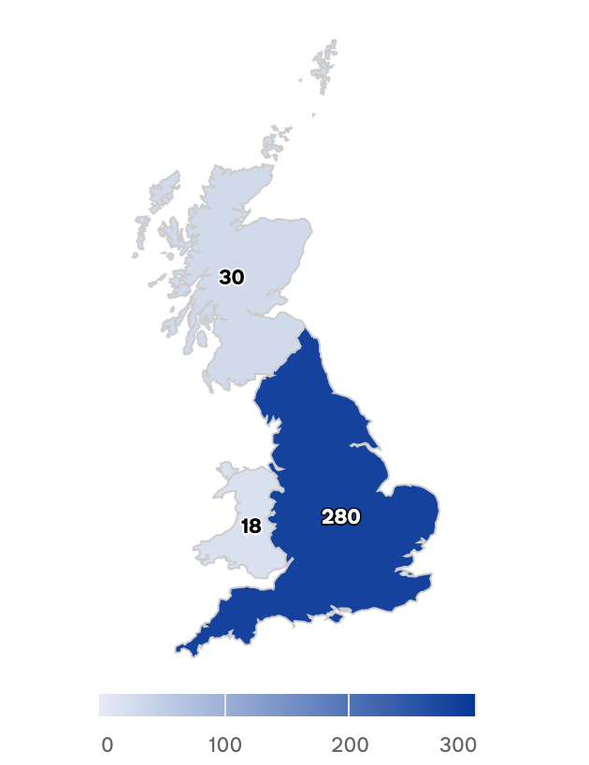
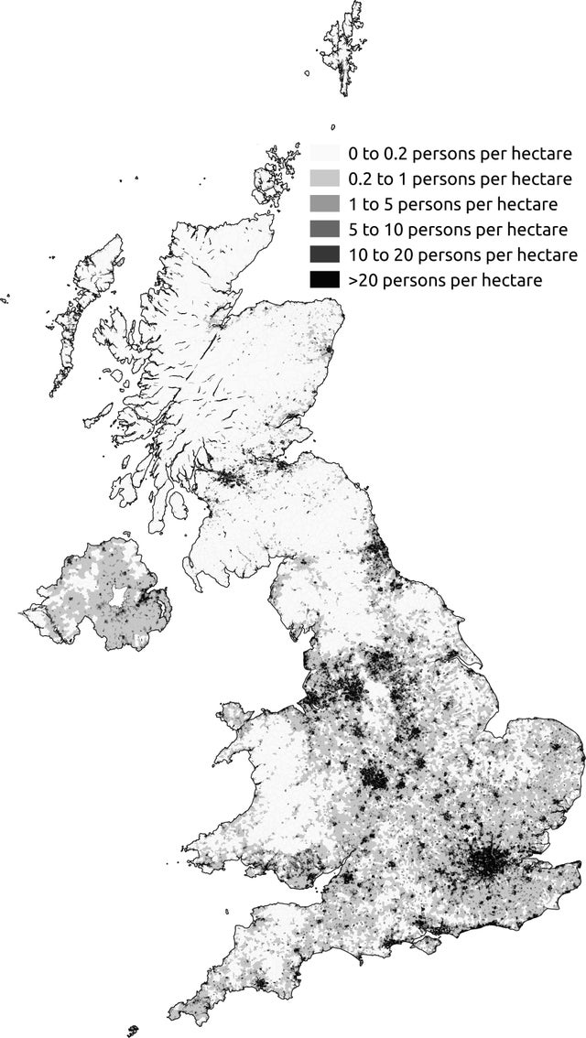

Great Britain
Great Britain
Population Density
2014 Great Britain
Road Accident Scatter Plot

Slide 6
Dataset

Slide 7
2014 Road Accident Data Set
Fairly Clean (Except LSOA)
Total Records
146322
Lots of Categorical Values

Slide 8
Officer Attendance (Imbalance Dataset)
1 – Yes
2 – No
(18% Cases not attended)

Slide 9
Features
Location
Conditions
Timing
Acc. Details
Location_Easting_OSGR
Location_Northing_OSGR
Longitude
Latitude
Police_Force
Local_Authority_(District)
Local_Authority_(Highway)
1st_Road_Class
1st_Road_Number
Junction_Detail
Junction_Control
2nd_Road_Class
2nd_Road_Class
Pedestrian_Crossing-Human_Control
Pedestrian_Crossing-Physical_Facilities
Urban_or_Rural_Area
Road Type
Speed_limit
Light_Conditions
Weather_Conditions
Road_Surface_Conditions
Special_Conditions_at_Site
Carriageway_Hazards
Date
Day_of_Week
Time
Accident Severity
Number_of_Vehicles
Number_of_Casualties

Slide 10
Exploratory Data Analysis

Slide 11
Accident Count By Month
October*
July *
November
January

Slide 12
Accident Count By Day of Week
1 Sunday
2 Monday
3 Tuesday
4 Wednesday
5 Thursday
6 Friday
7 Saturday
Friday seems to have the maximum number of incidents
Possibly look at other datasets like Beer Sales etc, to see if this is related
Possibly for people on the road going back home
Sunday is the lowest.
Would be interesting to see number of people on the road.
Possibly as it is a Church day
Avg. of 21K accidents per day of the week across the year
Notes:
Maximum Policy Attendance is 4441 per day*

Slide 13
Accident Count By Road Type
Road Type | Accident Count
Single carriageway | 110187 (5x)
Dual carriageway | 20823
Round About | 10329
One way street | 2935
Slip road | 1542
Unknown | 506

Slide 14
Accident Count By Bad Weather Conditions
Rain is the biggest cause of Road Accidents by Bad Weather Conditions

Slide 15
Accident Count By Severity
Most Accidents are Minor

Slide 16
Feature Engineering

Slide 17
Feature Correlation Matrix

Slide 18
Feature Selection
Columns Dropped
LSOA_of_Accident_Location '2nd_Road_Class', [Colinear] 'Junction_Control', [Colinear] 'Date’ (Changed Date to DateTime) 'Latitude', [Colinear Locaton_..] Longitude', [Colinear to Locaton_EastingOSGR] 'Accident_Index'

Slide 19
Feature Scaling
Features Scaled
- Change Time to Seconds
- Change Date to Python Date time for Scaling
Scale Location Easting and Northing Field
- Time Binning (Not Done)
- Created Dummy Variables for Categorical (Non H20 Models)

Slide 20
Modeling

Slide 21
Data Split
Train | Validation | Test
70% | 15% | 15%
* Imbalanced Dataset
* Over Sampling with SMOTE and ADASYN Tried

Slide 22
Algorithms Attempted (H2O)
Algorithm
H2OGradientBoostingEstimator
H2ORandomForestEstimator
H2OAutoML
H2OXGBoostEstimator
H2OStackedEnsembleEstimator
H2OStackedEnsembleEstimator (H2OGridSearch)
H2ODeepLearningEstimator
H2OSupportVectorMachineEstimator
H2ONaiveBayesEstimator

Slide 23
Algorithms Attempted Non- H20
Algorithms
XGBClassifier
Keras Deep NN
DecisionTreeClassifier
LinearSVC
AdaBoost*
CatBoost*

Slide 24
Model Evaluation

Slide 25
Model Evaluation Metrics
Model Evaluation Metrics are Business Contextual
Imbalanced Dataset
Cop shows up - 81.74%
Cop Not Showing up – 18.26%
Assumption
Cost of Police Not Showing up is High
Specificity/ Recall for Police Not Showing up

Slide 26
Model Performance
Algorithm | Recall ( Class 2)
H2ORandomForestEstimator | 0.69
AutoML | 0.66
H2OStackedEnsembleEstimator (H2OGradientBoostingEstimator, GridSearch) | 0.65
H2OGradientBoostingEstimator | 0.64
H2OStackedEnsembleEstimator (GBM, RF) | 0.62
H2OXGBoostEstimator | 0.60
Naïve Bayes | 0.71*
H2OSupportVectorMachineEstimator | 0.02

Slide 27
Feature Importance

Slide 28
Feature Importances

Slide 29
Production Deployment

Slide 30
Production Deployment
Take the Random Forest Model
Serialize it
Test it with more Production Data
Create a Micro Service or a Rest Web Service in Python/Java
Deploy in pilot regions
Integrate with a Emergency Road Assistance Service

Slide 31
More Work !!

Slide 32
More Actions
Discuss with Business Understand the use case better
Select the right Metrics
Fine tune the Algorithms better
Do more Feature Engineering
Time Scale Binning
Bring External Data Sources
Re tune the models with New Features

Slide 33
Thank You

